Slide 1

INT 221 - MVC PROGRAMMING
Laravel Request Life Cycle-
The route of Laravel Request passes from which phases

Slide 2
Seems but not true General Answer But it is not True
Route
Controller
View

Slide 3
public/index.php file –The Entry Point
The entry point for all requests to a Laravel application is the public/index.php file.
All requests are directed to this file by your web server (Apache / Nginx) configuration.
The index.php file doesn't contain much code.
Rather, it is a starting point for loading the rest of the framework

Slide 4
Index.php
The index.php file loads the Composer generated autoloader definition (when we install or update the composer), and then retrieves an instance of the Laravel application from bootstrap/app.php.
--loads composer generated files
The first action taken by Laravel itself is to create an instance of the Laravel application.

Slide 5
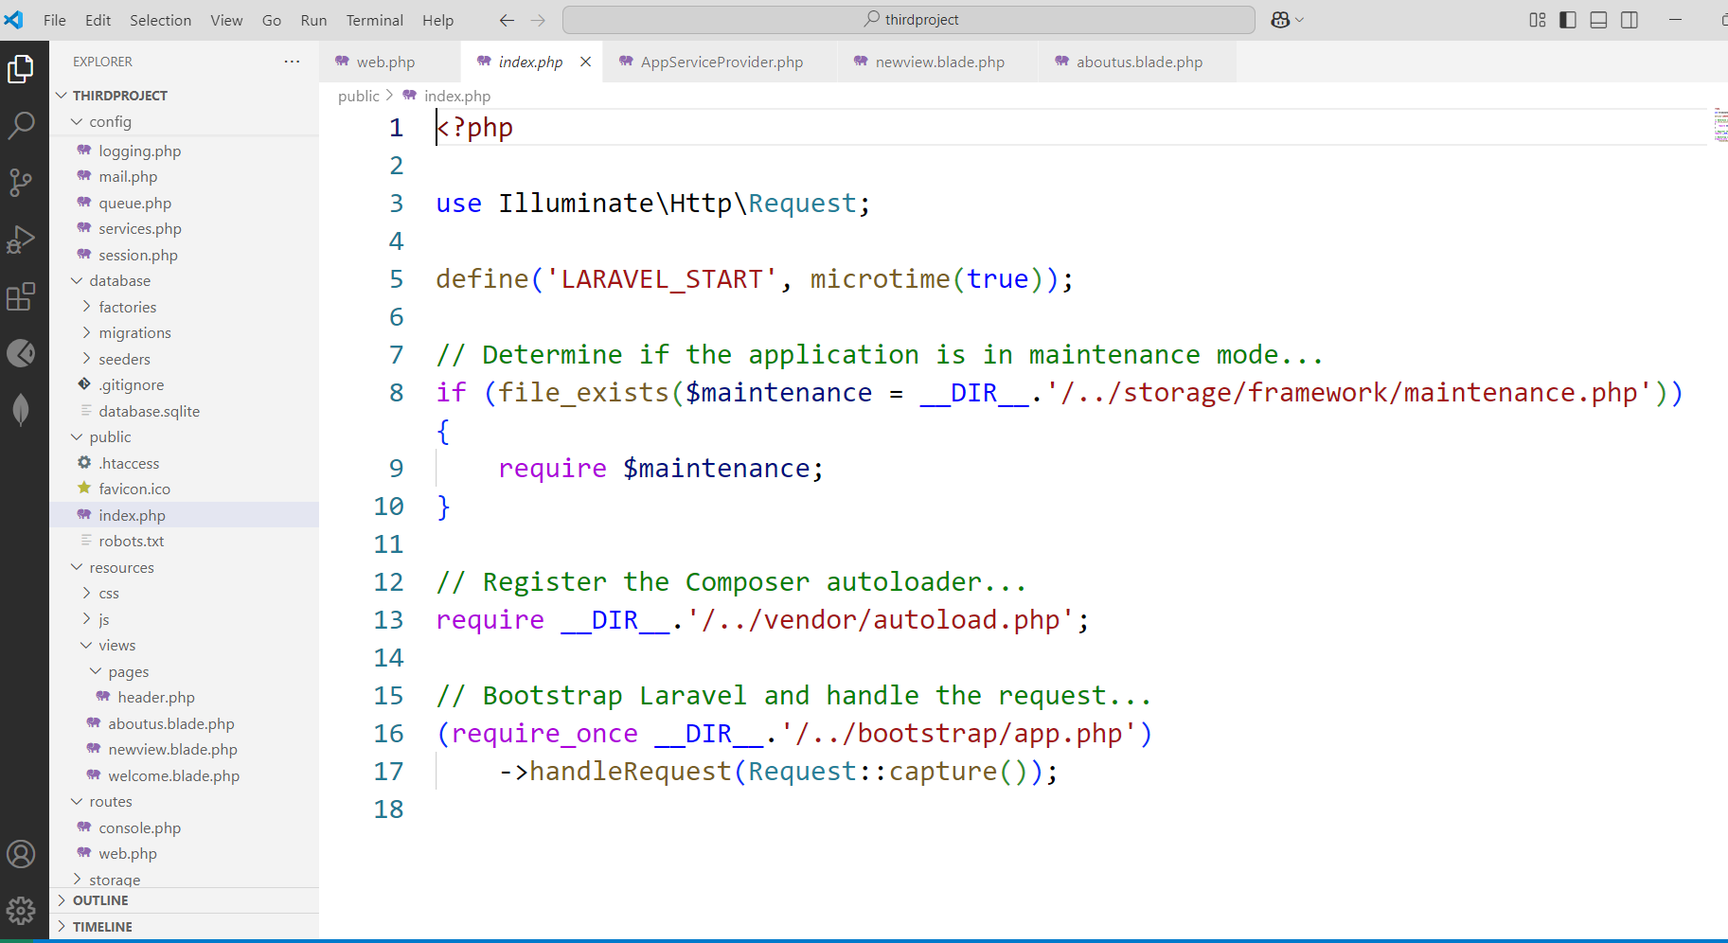
Structure of index.php file

Slide 6
What is in index.php??
// Register the Composer autoloader...
require __DIR__.'/../vendor/autoload.php’;
// Bootstrap Laravel and handle the request...
//responsible for instances
(require_once __DIR__.'/../bootstrap/app.php')
->handleRequest(Request::capture());

Slide 7
1. Entry Point: public/index.php
Every request to a Laravel application enters through public/index.php.
This file:Loads Composer’s autoloader.
Retrieves the Laravel application instance.

Slide 8
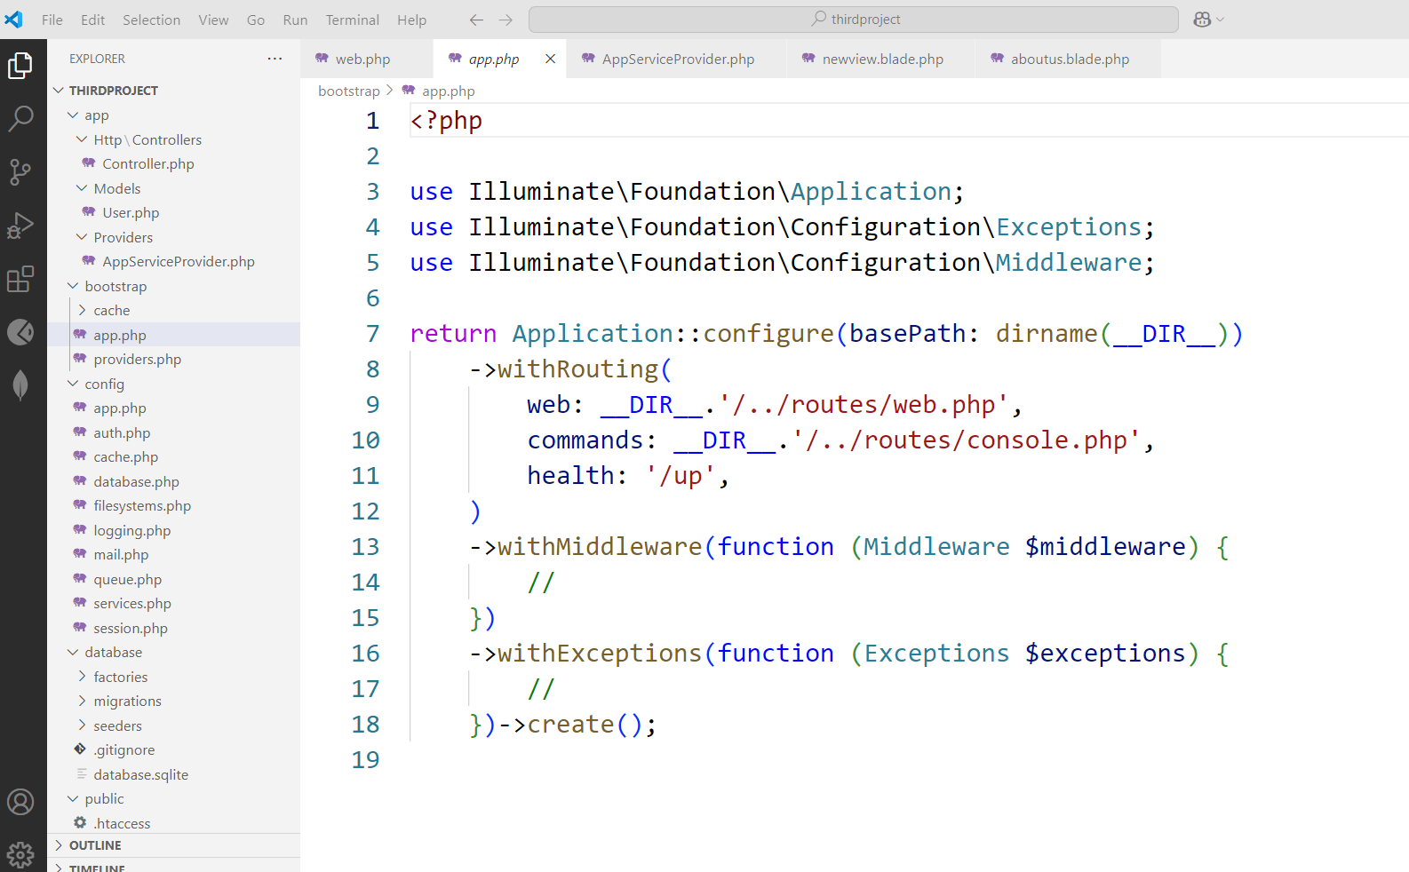
Bootstrap→app.php (Instances are made here)
The bootstrap/app.php file sets up the Laravel application instance. It binds essential interfaces and prepares Laravel's service container.

Slide 9
public/index.php
Bootstrap/app.php

Slide 10
Request is now sent to Kernels
Two Kernel based on the request
HTTP Kernels (hitting the URL via web browser)
Console Kernel (Task scheduling)

Slide 11
Bootstrap→app.php (Kernels)
->withRouting(
web: __DIR__.'/../routes/web.php',
commands: __DIR__.'/../routes/console.php',
health: '/up',
)
Handles the request

Slide 12
Service Provider
After kernel , the request is sent to Service Providers
Implement core functionality e.g. Mailing, Sessions etc.

Slide 13
Service providers
Service providers are responsible for bootstrapping all of the framework's various components, such as the database, queue, validation, and routing components, event management, session management.

Slide 14
bootstrap/providers.php
You can find a list of the user-defined or third-party service providers that your application is using in the bootstrap/providers.php file.

Slide 15
Laravel comes with some default service providers:-
App\Providers\AppServiceProvider.php
(in Laravel-11)
App\Providers\AuthServiceProvider.php
App\Providers\BroadcastServiceProvider.php
App\Providers\EventServiceProvider.php
App\Providers\RouteServiceProvider.php

Slide 16
Service Providers Loading (bootstrap/providers.php)
Laravel loads all registered service providers to initialize core services like database, authentication, routing, etc.

Slide 17
Providers
Config→Appserviceprovider- to declare the globalvariables (custom stuff)

Slide 18
Routes →(routes/web.php)
Once the application has been bootstrapped and all service providers have been registered, the Request will be handed off to the router for dispatching.
The router will dispatch the request to a route or controller, as well as run any route specific middleware.
Laravel finds the appropriate route that matches the request URL.

Slide 19
Middleware (using construct method)
Middleware provide a convenient mechanism for filtering or examining HTTP requests entering your application.
For example, Laravel includes a middleware that verifies if the user of your application is authenticated.
If the user is not authenticated, the middleware will redirect the user to the login screen. However, if the user is authenticated, the middleware will allow the request to proceed further into the application.

Slide 20
Middleware Execution
Authenticate users.
Log requests.
Validate input data.

Slide 21
Example Middleware (app/Http/Middleware/CheckAge.php)
public function handle($request, Closure $next)
{ if ($request->age < 18) {
return response('Unauthorized', 403);
}
return $next($request);
}

Slide 22
Controller
In Laravel, controllers are found in the app/Http/Controllers directory.
They help organize request handling logic by grouping related functions into classes.

Slide 23
View
If the route returns an HTML view, Laravel loads a Blade template.

Slide 24
(resources/views/home.blade.php)
<!DOCTYPE html>
<html>
<head>
<title>
{{ $title }}
</title>
</head>
<body>
<h1>Hello, Laravel!</h1>
</body>
</html>

Slide 25
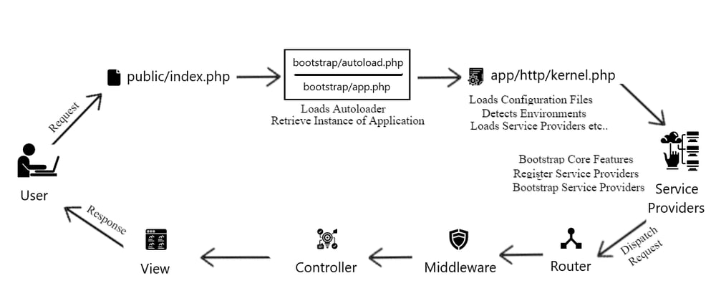
Laravel Request Life Cycle

Slide 26
Video
https://www.youtube.com/watch?v=4Kf6y3Tb4uM&ab_channel=HadayatNiazi

